Slide 1
Bacterial and Viral Agents of Bioterrorism A Quick Overview
Prof. Adeel Ajwad Butt, MD, MS, FACP, FIDSA
Professor of Medicine, Weill Cornell Medical College
Vice chair, Department of Medicine, HMC
Fulbright Scholar, Yale/Johnson & Johnson Scholar in International Health

Slide 2
Overview
History of biologic weapons
What makes an effective biologic weapon?
Scale of the problem
Classification and categories
Response and Countermeasures
How prepared are we?

Slide 3
Reality check
"The cold reality is that it is almost impossible to enforce the existing biological weapons treaty. There is no biological weapons facility, which if shut down today could not be rebuilt tomorrow … "
Joshua Lederberg
President emeritus, The Rockefeller University
(won a Nobel prize in 1958 at age of 33)

Slide 4
Wars vs. Infections
Infectious Diseases Pandemics
Wars
95% of pre-Columbian native-American population killed by new diseases e.g. smallpox, measles, plague, typhoid, influenza
75 million deaths worldwide (25% of the population) killed by bubonic plague in the 14th century
21 million deaths due to influenza pandemic of 1918-1919
WW1: 18 million deaths
WW2: ~21 million military deaths
Mongol conquests: 11-40 million deaths
American civil war: 620,000 deaths
Chinese revolution 1911: 2.4 million

Slide 5
What is bioterrorism?
Bioterrorism:
Biologic agents or toxins
Intentional/
Hostile
Coercive/
Intimidatory
Harmful
Intention of harm to humans, plants or other living organisms
To influence conduct of government or to intimidate or coerce a civilian population
Generally cause systemic disease, e.g. hemorrhagic fever, pneumonias, shock

Slide 6
HISTORY

Slide 7
History
The earliest documented incident of the intention to use biological weapons is recorded in Hittite texts of 1500–1200 BC, in which victims of tularemia were driven into enemy lands, causing an epidemic
According to Homer's epic poems about the legendary Trojan War, the Iliad and the Odyssey, spears and arrows were tipped with poison.
During the First Sacred War in Greece, in about 590 BC, Athens and the Amphictionic League poisoned the water supply of the besieged town of Kirrha (near Delphi) with the toxic plant hellebore.
During the 4th century BC Scythian archers tipped their arrow tips with snake venom, human blood, and animal feces to cause wounds to become infected.

Slide 8
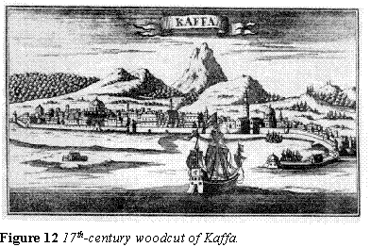
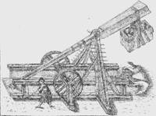
History
14th century siege of Kaffa by the Tartars
Catapulted cadavers infected with plague
Although plague did eventually lead to the surrender of Kaffa, most experts doubt the cadavers were effective
Plague epidemic and infected rodents were already in the area (hence the cadavers), the fleas that transmit the disease greatly prefer plague infected rodents to cadavers

Slide 9
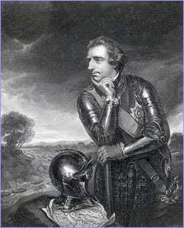
History
18th Century - British commander Sir Jeffrey Amherst orders blankets used in smallpox clinic given to Native Americans as gifts
Smallpox is spread most effectively through direct inhalation of respiratory droplets (coughing), blankets were likely not that contagious
Although a devastating smallpox epidemic did occur among Native Americans at this time, previous contact with early settlers is likely the major cause

Slide 10
History: confirmed military examples
Various native warriors dipped arrows and spears in biological poisons (ex. “arrow frogs” of South America)
In WWI, Germans targeted livestock and cavalry horses in various European countries using animal specific diseases. This was apparently very successful
In WWII, Japanese admitted to launching at least 11 attacks on Chinese cities using pathogens including Anthrax, Cholera, Salmonella, and Plague
Unknown civilian casualty numbers, but believed to be in the tens of thousands, in addition to over 10,000 deaths of Chinese prisoners used for experiments

Slide 11
History: civilian terrorism/criminal examples
1984 in rural Oregon a religious cult infected 751 residents with food poisoning through Salmonella contamination at 10 restaurants in an attempt to win local elections.
Early 1990’s the Japanese Aum Shrinrikyo cult released Anthrax in Tokyo, but no known victims. Apparently, this was not “weaponized” correctly.
1996 the pathogen that causes dysentery was introduced into pastries in the break room of the St. Paul’s Medical Center in Dallas, infecting 45.
September of 2001 Anthrax laden letters sent to several locations in US. 22 confirmed cases of anthrax were reported, 11 cases of inhalation anthrax, 5 deaths.

Slide 12
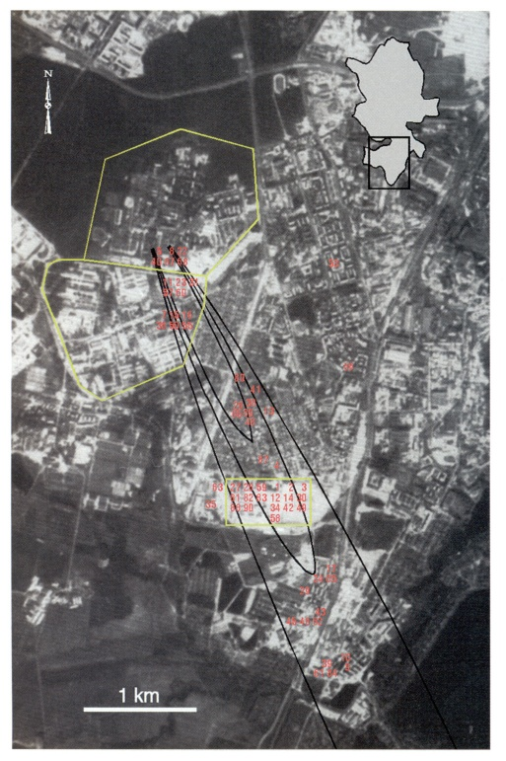
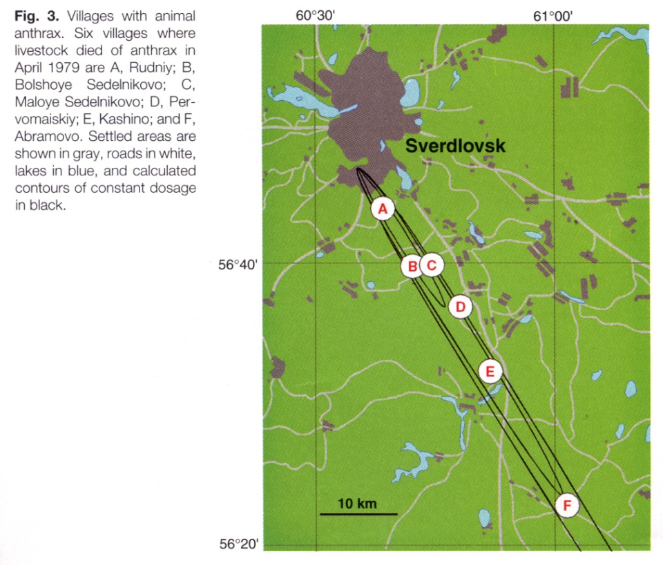
History: accidents
In 1979 a few milligrams to 1 gram of weaponized anthrax were released from manufacturing plant in Sverdlovsk, Russia.
Downwind of the accidental release, 66 people died of 77 known patients
The U.S. was not able to confirm this until 1994

Slide 13
EFFECTIVE BIOLOGIC WEAPONS

Slide 14
What makes an effective biologic weapon?
Must be virulent and lethal
Must be able to survive outside the human body
Quick acting
Easily dispersible
Inexpensive to grow
Not require sophisticated equipment to grow
Ability to weaponize

Slide 15
Why are these agents a big threat?
Easy to make
Easy to conceal
Cheap
Little military significance thus far, but tremendous propaganda value
Mass hysteria and fear
Disruption of public order

Slide 16
Threat of biologic weapons
Difficult to detect, even after use
Unreliable but open-ended scale of predictable casualties
Clandestine stockpiles and delivery systems

Slide 17
Is a biologic weapon attack more likely today?
Global conflicts
More non-state actors
Asymmetric warfare
Ease and rapidity of travel
Advances in technology, easily accessible to everyone
Value of propaganda

Slide 18
Risk of dying
Smoking 10 cigarettes a day One in 200
Road accident One in 8,000
Playing soccer One in 25,000
Homicide One in 100,000
Terrorism attack in 2001 One in 100,000
Hit by lightning One in 10,000,000
Terrorism attack in 1990’s One in 50,000,000
Anthrax in 2001 One in 50,000, 000
Smallpox in 2001 Less than one in 50,000,000

Slide 19
CLASSIFICATION AND CATEGORIES

Slide 20
Categories of biologic threat agents
Category A
Easily spread; high mortality; public panic; pose a high risk to national security
B. anthracis, C. botulinum
Category B
Moderately easy to spread; moderate illness rate; low mortality;
Brucella, typhus,
Category C
Easily available, produced and spread; high mortality; major health impact;
Nipah, tick-borne encephalitis

Slide 21
Categories of biologic threat agents
Category A | Category B | Category C
Variola major (small pox) Bacillus anthracis (anthrax) Yersinia pestis (plague) Clostridium botulinum toxin (botulism) Francisella tularensis (tularaemia) Filoviruses, Ebola hemorrhagic fever Marburg hemorrhagic fever Arenaviruses, Lassa (Lassa fever) Junin (Argentine hemorrhagic fever) | Coxiella burnetti (Q fever) Brucella species (brucellosis) Burkholderia mallei (glanders) Burkholderia pseudomallei (Melioidosis) Alphaviruses, Venezuelan encephalomyelitis, Eastern and Western equine, Encephalomyelitis Ricin toxin from Ricinus communis (Castor bearns) Epsilon toxin of Clostridium perfringens Staphylococcal enterotoxin B Food- or waterborne pathogens: Salmonella, Shigella, Escherichia coli 0157:H7 Vibrio cholerae, and Cryptosporidium parvum Rickettsia prowaken (Typhus fever) | Nipah virus Hantaviruses Tickborne hemorrhagic fever viruses Tickborne encephalitis viruses Yellow Fever

Slide 22
Potential bacterial and viral bioweapons
Anthrax
Plague
Smallpox
Tularemia
Equine encephalitis
Hemorrhagic fevers
Botulinum
Ricin
Tricothecene mycotoxins
Staphylococcal enterotoxins
Toxins from marine algae

Slide 23
Most likely agents
Disease | Symptoms | Treatment
Anthrax (bacterium) | High Fever, labored breathing | antibiotic, vaccine
Small Pox Fever (virus) | Headache, vomiting | vaccine, cidofovir
Botulism (bacteria toxin) | Nausea, fatigue, cramps, headache, respiratory paralysis | equine antitoxin
Plague (bacterium) | Lung infection, pneumonia | antibiotic, vaccine

Slide 24
Components of a biologic weapons system
Payload
BW agent itself
Munition
Carrier to target site
Delivery system
Missile, vehicle, artillery shell
Dispersion system
Aerosol sprays, explosives, food
Notes:
The Biological weapons system is comprised of four components; a payload, munition, delivery system and dispersion system. The payload is the biological agent itself. The munition protects and carries the payload to maintain its potency during delivery. The delivery system can be a missile, vehicle (aircraft, boat, automobile or truck), or an artillery shell. The dispersion system ensures dissemination of the payload at the target site. Potential methods of dispersion are aerosol sprays, explosives, and food or water contamination. Aerosol sprays are the most effective means of widespread dissemination. Depending on atmospheric conditions and the agent itself, infectious material could travel several hundred kilometers in a particle size that upon inhalation would be delivered to the terminal airways. However factors like particle size of the agent, stability of the agent under desiccating conditions and ultraviolet light, wind speed, wind direction, and atmospheric stability can alter the effectiveness of a given delivery system. Explosions are likely to inactivate biological agents and therefore are not very effective in disseminating infectious materials. Contamination of water supplies generally requires an addition of an unrealistically large amount of biological agent(s) to a city supply. The agents may be introduced into smaller reservoirs or into the water supply after the water passes through its purification facility. Food supplies are easier to contaminate than water supplies. The outbreaks from food source may be dismissed as a "natural" event early during a bioterrorism attack.

Slide 25
Effective biologic weapon
Effective Bioweapon
Consistent effect
Short & predictable incubation period
Infective in low doses
Disease difficult to identify
Highly contagious
Easy to produce, store, weaponize
Target population has no immunity

Slide 26
Impact
Mortality impact
1 kg of anthrax powder can kill up to 100,000 persons
Economic impact
Brucella: $478 million per 100,000 persons exposed
Anthrax: $26.2 billion per 100,000 persons exposed

Slide 27
RESPONSE

Slide 28
Unique challenges
Bioweapons attacks can be overt or covert
Covert attacks are more likely and pose unique challenges
Delay between exposure and onset of illness
Difficulty in identifying the attack
Difficulty in identifying the organism
Inadequate infection control procedures
Overwhelming of response systems before identification of attack
Clues
Outbreak of new or rare disease
Outbreak in a non-endemic area
Clusters with possible common exposure
Unusual prescription patterns
VERY HIGH INDEX OF SUSPICION

Slide 29
Addressing the threat
Intervention
Prevention
Recognition
The key to recognizing new or emerging infectious diseases, and to tracking the prevalence of more established ones, is surveillance.
The response to an emerging infectious agent or disease necessitates coordinated efforts by various individuals, organizations, and industries (vaccine development, vector control, continued research, education of the public, etc)
“Data are the building blocks of knowledge and the seeds of discovery. They challenge us to develop new concepts, theories, and models to make sense of the patterns we see in them.” (Joshua Lederberg: Committee on the Judiciary U.S. House of Representatives 18 March 1999)

Slide 30
Model State Emergency Health Powers Act
Preparedness, comprehensive planning for a Public Health emergency;
Surveillance, measures to detect and track Public Health emergencies;
Ensuring adequate availability of vaccines, pharmaceuticals and hospitals as well as providing power to abate hazards to the Public's Health;
Powers to compel vaccination, testing, treatment, isolation and quarantine when clearly necessary;
Communication, providing clear and authoritative information to the public.
The act also contains a modernized, extensive set of principles and requirements to safeguard personal rights.

Slide 31
Countermeasures: governmental responses
Regulatory framework
Expedited procedures
Emergency use of unapproved products
Market guarantee
Reporting requirements
Acquisitions and stockpiling
Ongoing research
Education and training
Appropriations

Slide 32
Role of infectious diseases specialists
Anticipation of threat agents and modalities of dissemination, and their public health impact
Assistance to local emergency authorities in planning for consequence management of a BW attack
Participating in local public health teams in the epidemiological investigation and definitive diagnosis of suspicious outbreaks
As central agents in the medical and public health management of outbreaks, and of their further consequences for the life of the community

Slide 33
Role of infectious diseases specialists
Assisting other branches of government in authentic assurance and guidance to the public, in averting panic and chaos
Where appropriate, assisting in measures to limit the further spread of contagious agents, and to decontaminate impacted facilities
Ongoing basic and translational research to sharpen the tools available for all these functions, and further training of colleagues and supporting personnel

Slide 34
Are we there yet?
Operation Dark Winter
An attack on the United States with biological weapons could threaten vital national security interests. Massive civilian casualties, breakdown in essential institutions, violation of democratic processes, civil disorder, loss of confidence in government and reduced U.S. strategic flexibility abroad are among the ways a biological attack might compromise U.S. security.
Current organizational structures and capabilities are not well suited for the management of a BW attack. Major "fault lines" exist between different levels of government (federal, state, and local), between government and the private sector, among different institutions and agencies, and within the public and private sector. These "disconnects" could impede situational awareness and compromise the ability to limit loss of life, suffering, and economic damage.
Notes:
An attack on the United States with biological weapons could threaten vital national security interests. Massive civilian casualties, breakdown in essential institutions, violation of democratic processes, civil disorder, loss of confidence in government and reduced U.S. strategic flexibility abroad are among the ways a biological attack might compromise U.S. security.
2. Current organizational structures and capabilities are not well suited for the management of a BW attack. Major "fault lines" exist between different levels of government (federal, state, and local), between government and the private sector, among different institutions and agencies, and within the public and private sector. These "disconnects" could impede situational awareness and compromise the ability to limit loss of life, suffering, and economic damage.
3. There is no surge capability in the U.S. healthcare and public health systems, or in the pharmaceutical and vaccine industries. This institutionally limited surge capacity could result in hospitals being overwhelmed and becoming inoperable, and it could impede public health agencies' analysis of the scope, source and progress of the epidemic, their ability to educate and reassure the public, and their capacity to limit causalities and the spread of disease.
4. Dealing with the media will be a major immediate challenge for all levels of government. Information management and communication (e.g., dealing with the press effectively, communication with citizens, maintaining the information flows necessary for command and control at all institutional levels) will be a critical element in crisis/consequence management.
5. Should a contagious bioweapon pathogen be used, containing the spread of disease will present significant ethical, political, cultural, operational, and legal challenges

Slide 35
Are we there yet?
Operation Dark Winter
There is no surge capability in the U.S. healthcare and public health systems, or in the pharmaceutical and vaccine industries. This institutionally limited surge capacity could result in hospitals being overwhelmed and becoming inoperable, and it could impede public health agencies' analysis of the scope, source and progress of the epidemic, their ability to educate and reassure the public, and their capacity to limit causalities and the spread of disease.
Dealing with the media will be a major immediate challenge for all levels of government. Information management and communication (e.g., dealing with the press effectively, communication with citizens, maintaining the information flows necessary for command and control at all institutional levels) will be a critical element in crisis/consequence management.
Should a contagious bioweapon pathogen be used, containing the spread of disease will present significant ethical, political, cultural, operational, and legal challenges

Slide 36
Summary and Conclusions
Threat of a biologic weapons attack is real
Effective response to such threat should be a high priority
Highly coordinated efforts between various ministries, public health officials, first-responders, healthcare systems and the healthcare workforce are essential
Effective strategy requires surveillance, education, training, legislation, coordination and regular simulation exercises
In case of an attack, post-attack strategies include quarantine, vaccination, antibiotic prophylaxis and treatment, antibodies/antitoxins

